Slide 1
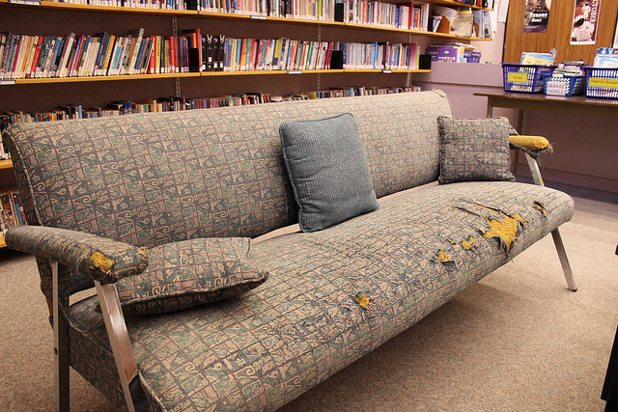
This is the inside of your library
https://www.flickr.com/photos/gibsonsgolfer/6793949719/

Slide 2
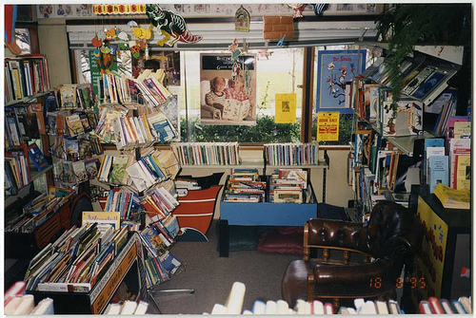
This is the inside of your library
https://www.flickr.com/photos/christchurchcitylibraries/3134272707

Slide 3
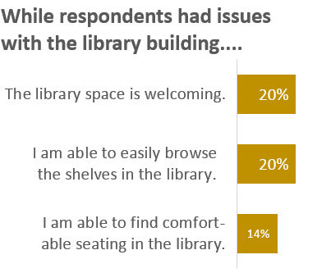
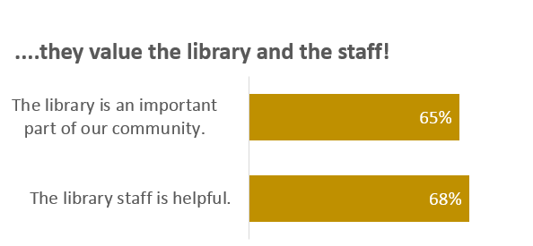

Slide 4
Visualization planning template
Who is the audience?
What do you want them to know?
What action do you want based on this knowledge?
How will this visualization be presented?
What is the tone?
What data do you have?
Describe the visualization you want to create

Slide 5
Who is the audience?
Be specific as possible
Think about how they might perceive you
Think about what drives them
Notes:
Be specific. If you are trying to communicate to too many audiences as once, you won’t communicate well to anyone as you could if you targeted your audience.
Perception: individuals who are using the library vs. people who do not; funders who may not have a clue! What may weaken the case in their eyes?
What drives them: what are their goals and interests? How can you tell a story that fits with that?

Slide 6
What do you want them to know?
Clearly
Concisely (think elevator speech!)
Notes:
If you could share one point or idea with them, what would it be?
This needs to be CLEAR and SPECIFIC in your mind. If you can’t answer that question, you don’t need to visualize the data
Why might this be interesting?

Slide 7
What action do you want based on this knowledge?
Say what you want
If you don’t know, say that, too

Slide 8
How will this visualization be presented?
In person?
In something sent to a specific audience?
On a website?
Notes:
This determines the amount of control and explanation you will have
Less control means more detail!
You may need to create something that works in both situations.
Consider the background information needed: what do they already know? Need to know?

Slide 9
What is the tone?
Celebration?
Neutral?
Scary?
Notes:
This determines the amount of control and explanation you will have
Less control means more detail!
You may need to create something that works in both situations.

Slide 10
Scenario

Slide 11
Types of charts available and when to use what

Slide 12
Heat map

